Slide 1
Traffic Prediction for Urban Planning
Fangzheng Xu
Supervised by: Kenny Q. Zhu
IEEE Class
Computer Science and Engineering
Shanghai Jiao Tong University

Slide 2
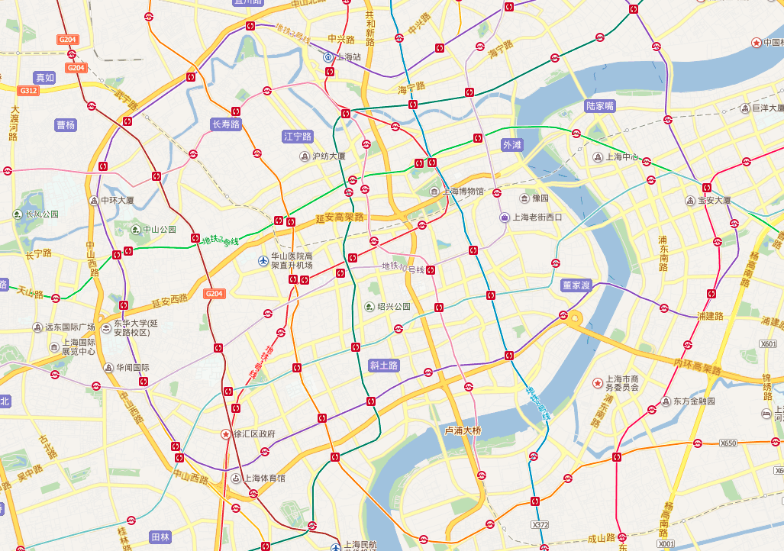
Why Traffic Prediction?
Travel Planning
Urban Planning
Transport Distribution
Notes:
Why we need traffic prediction? It is useful for many purposes

Slide 3
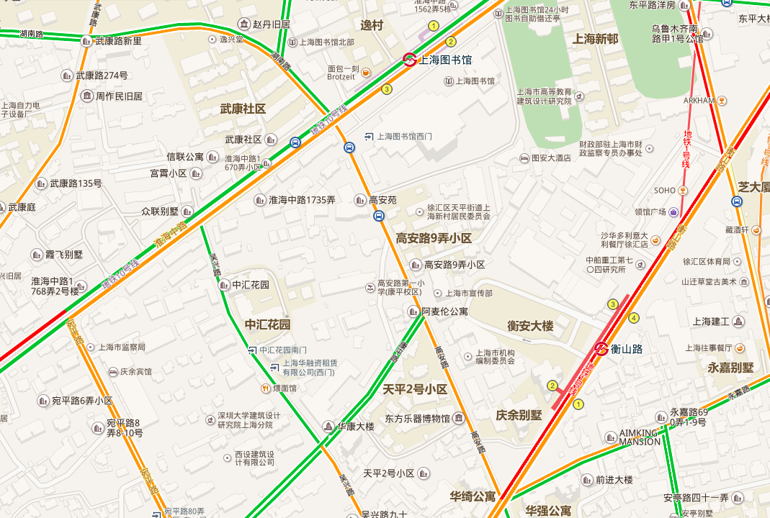
Predict traffic somewhere at future time
Now

Slide 4
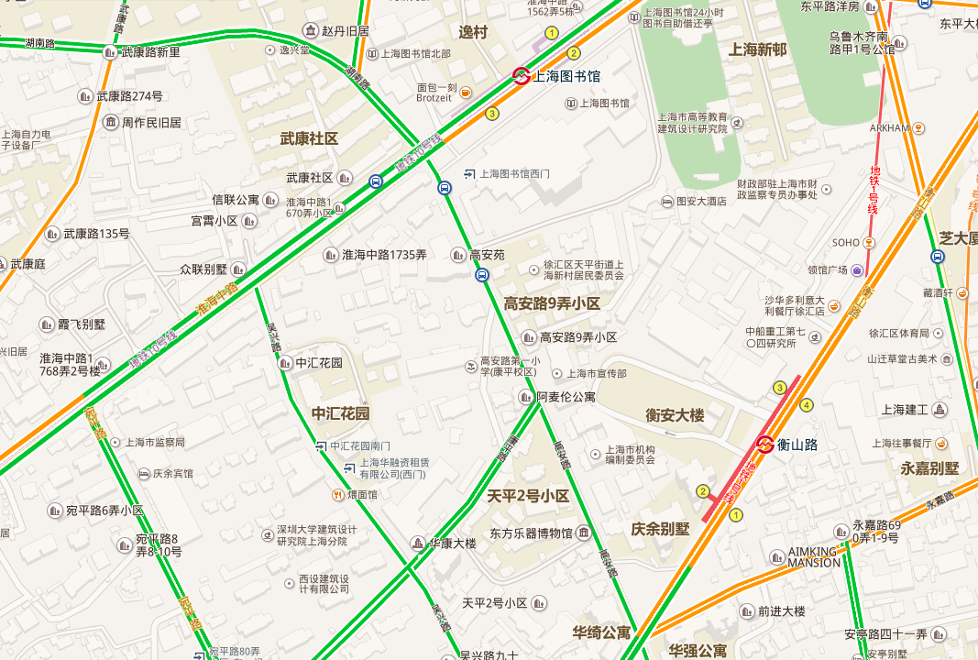
Predict traffic somewhere at future time
Predict traffic somewhere at future time
1 hour later

Slide 5
Make some urban planning changes!
Add a new road?

Slide 6
Make some urban planning changes!
Good for traffic!

Slide 7
Make some urban planning changes!
Build a new shopping mall?
?

Slide 8
Make some urban planning changes!
Cause traffic jam!
?

Slide 9
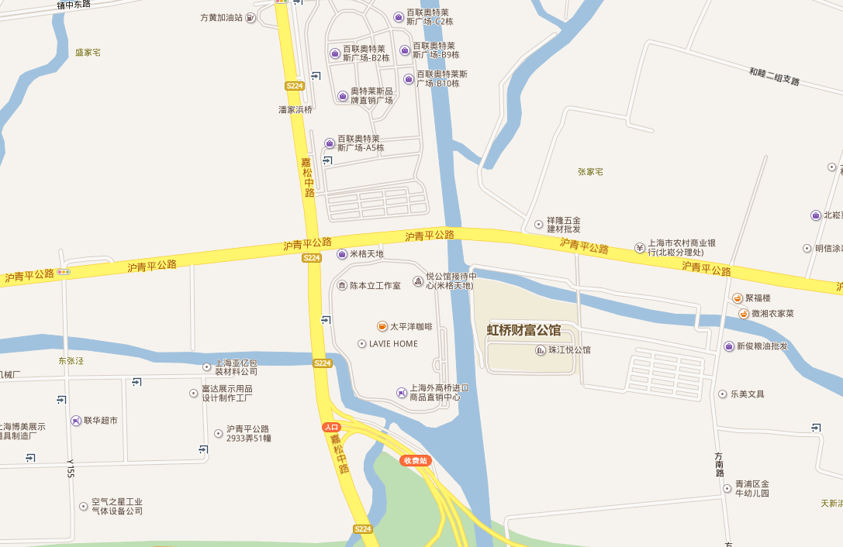
Verification of traffic on urban planning
New district
A good planning?

Slide 10
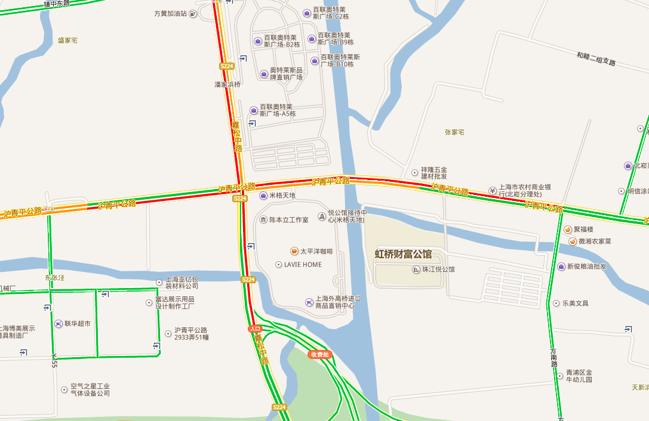
Verification of traffic on urban planning
Prone to traffic jam!

Slide 11
Our Goal
Build a system to predict traffic conditions on any roads given map of the area, time and other variables.
Input: road network map, points of interests, time, and the weather condition, etc.
Output: 4 classes at each spot: green (good), yellow (slow), red (congested) and deep red (extremely congested).

Slide 12
We need to collect data
Baidu Map seems to have all information
However…

Slide 13
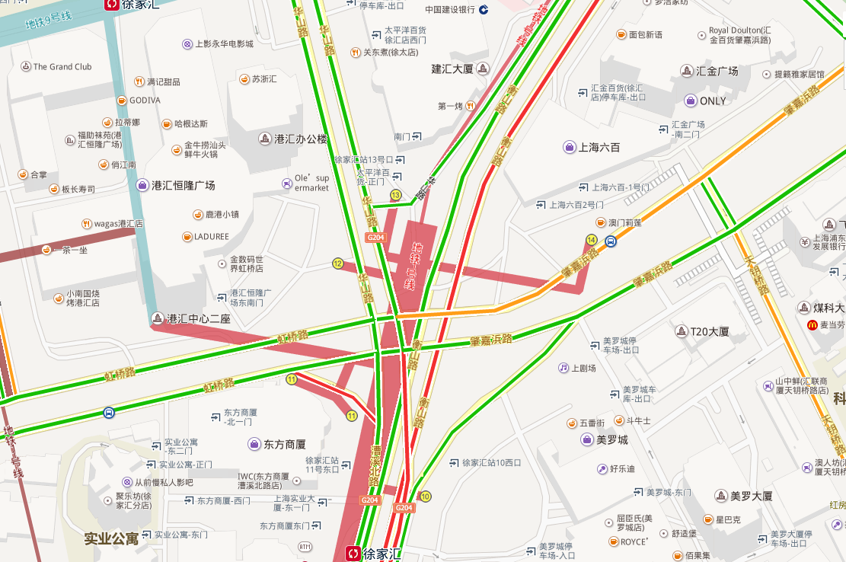
Challenges
Baidu Map
No vector map, only images

Slide 14
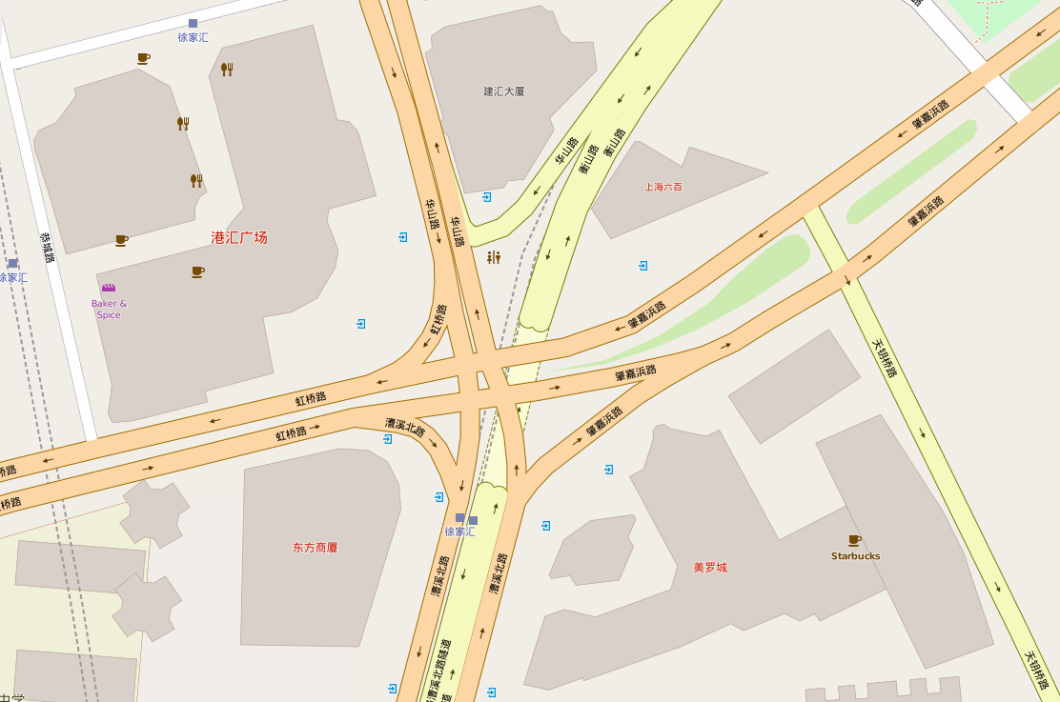
Challenges
OpenStreetMap
Vector data
Lacks lots of POIs in China
No real-time traffic information
Notes:
Vetor data

Slide 15
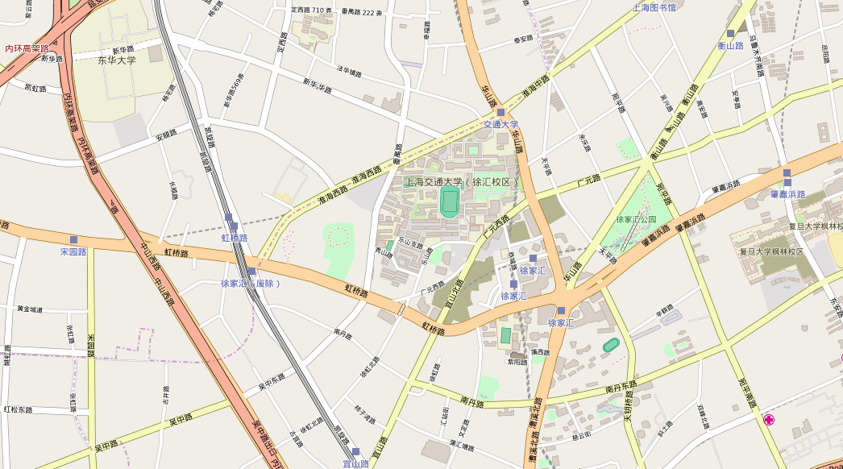
Map data from OpenStreetMap
Free and open source
Good precision
Great data schema

Slide 16
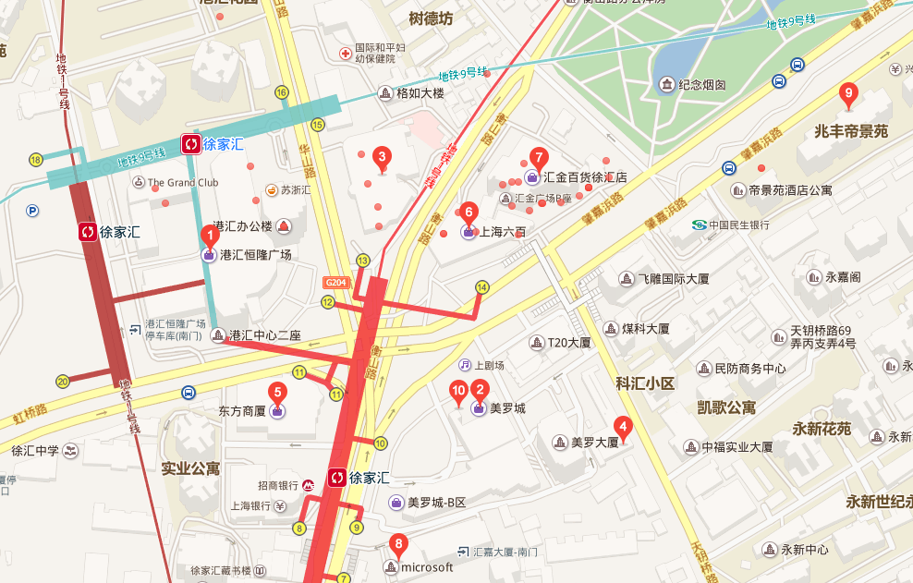
Points of Interest from Baidu Map
Recursively query and crawl
Notes:
Query API and crawl

Slide 17
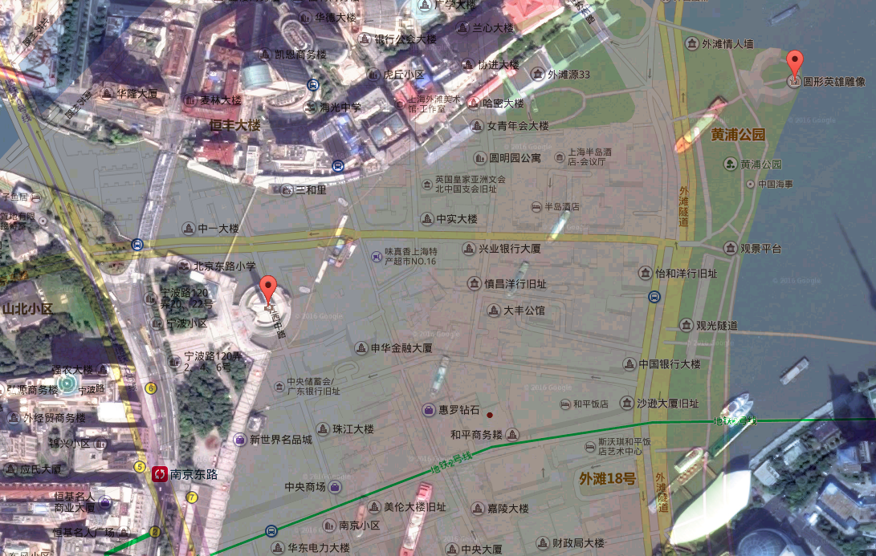
Challenges
Baidu’s distorted coordinates
BD-09
1.1 km
WGS-84
Notes:
Distorted over real GPS ones, which is OpenStreetMap

Slide 18
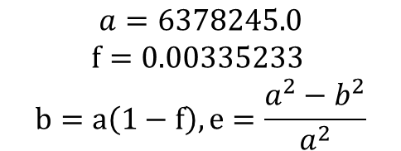
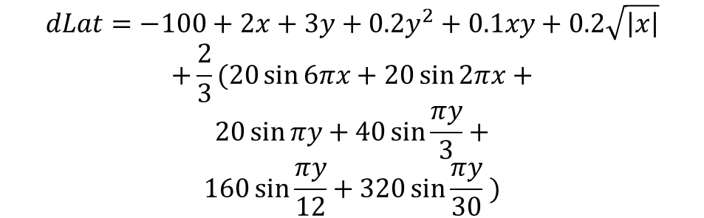

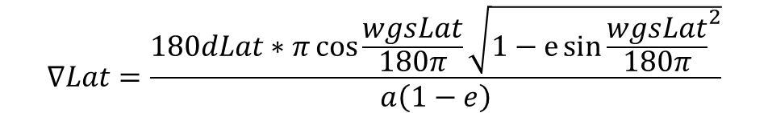
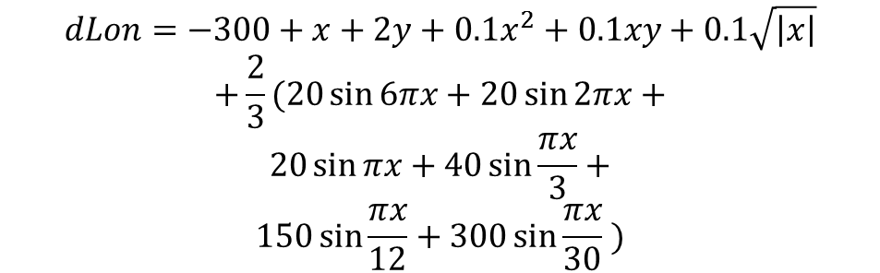
$$x=wgsLat−105, y=wgsLon−35$$
OpenStreetMap: WGS-84
$$dLat=−100+2x+3y+0.2y^{2}+0.1xy+0.2\sqrt{\left|x\right|}$$
$$+\frac{2}{3}(20\sin{6πx}+20\sin{2πx}+$$
$$20\sin{πy}+40\sin{\frac{πy}{3}}+$$
$$160\sin{\frac{πy}{12}}+320\sin{\frac{πy}{30}} )$$
Decrypt
Encrypt
Government: GCJ-02
$$dLon=−300+x+2y+0.1x^{2}+0.1xy+0.1\sqrt{\left|x\right|}$$
$$+\frac{2}{3}(20\sin{6πx}+20\sin{2πx}+$$
$$20\sin{πx}+40\sin{\frac{πx}{3}}+$$
$$150\sin{\frac{πx}{12}}+300\sin{\frac{πx}{30}} )$$
Decrypt
Encrypt
Baidu Map: BD-09
$$∇Lat=\frac{180dLat∗π\cos{\frac{wgsLat}{180π}}\sqrt{1−e{\sin{\frac{wgsLat}{180π}}}^{2}}}{a\left(1−e\right)}$$
$$a=6378245.0$$
$$f=0.00335233$$
$$b=a\left(1−f\right), e=\frac{a^{2}−b^{2}}{a^{2}}$$
$$∇Lat=\frac{180dLon∗π\sqrt[\frac{3}{2}]{1−e{\sin{\frac{wgsLat}{180π}}}^{2}}}{a}$$
Reverse: Numerical Approximation!
Notes:
Intractable

Slide 19
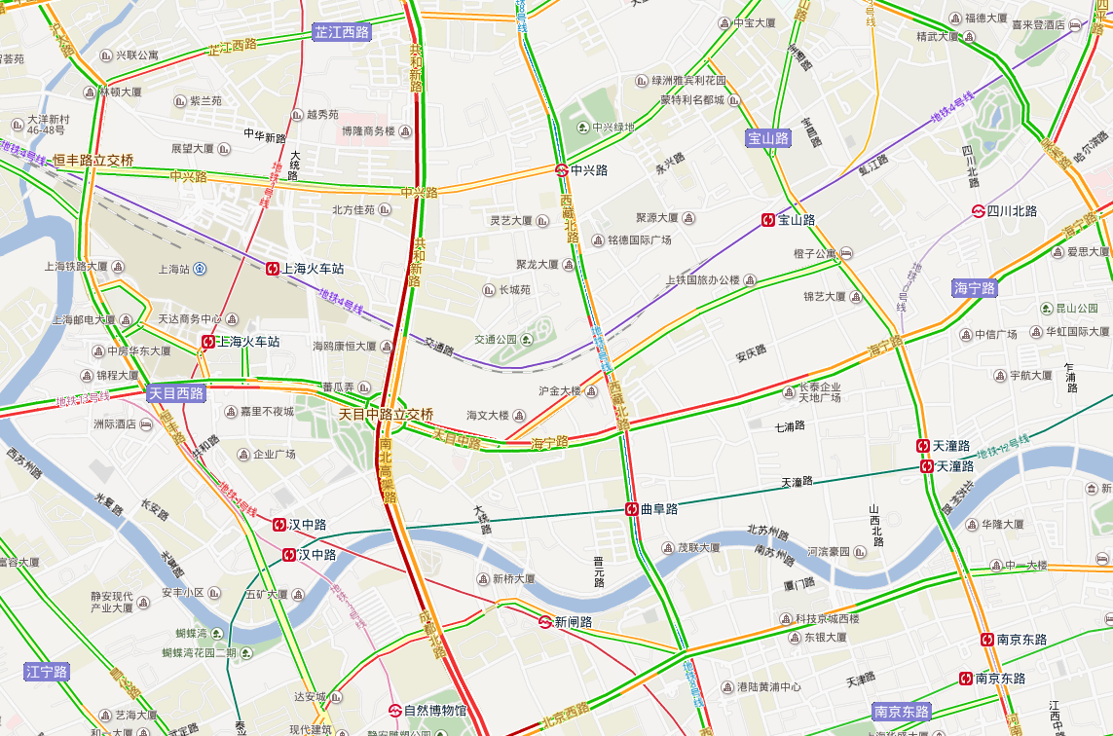
Traffic data from Baidu Map
Yellow – Slow
Deep Red – Extremely Congested
Red – Congested
Green - Good
Notes:
Next, we have to get traffic data

Slide 20
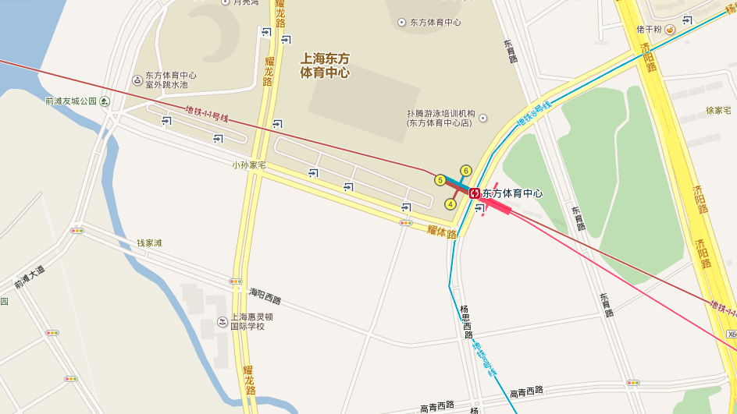
Baidu Map

Slide 21

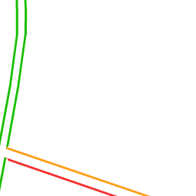

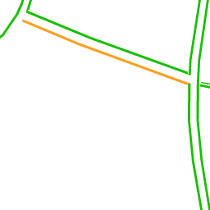
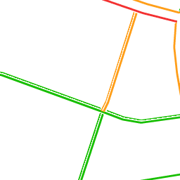
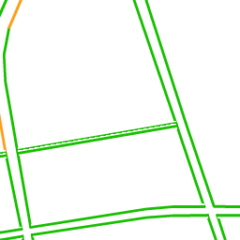
With traffic

Slide 22
Traffic tile
Notes:
Crawl and combine

Slide 23
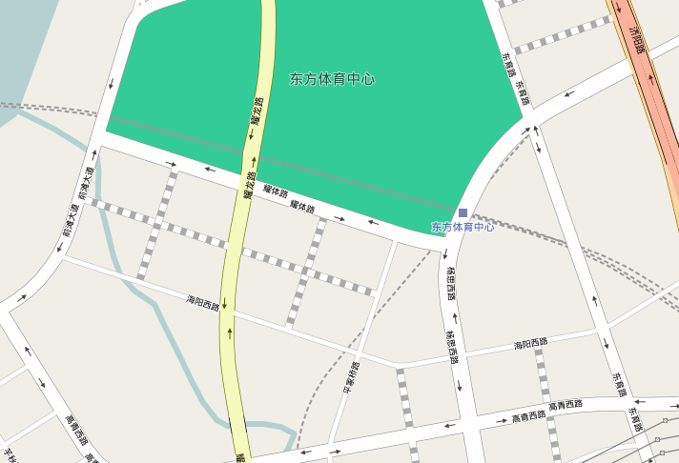
With OpenStreetMap
After coordinate transform
Still no exact match!

Slide 24
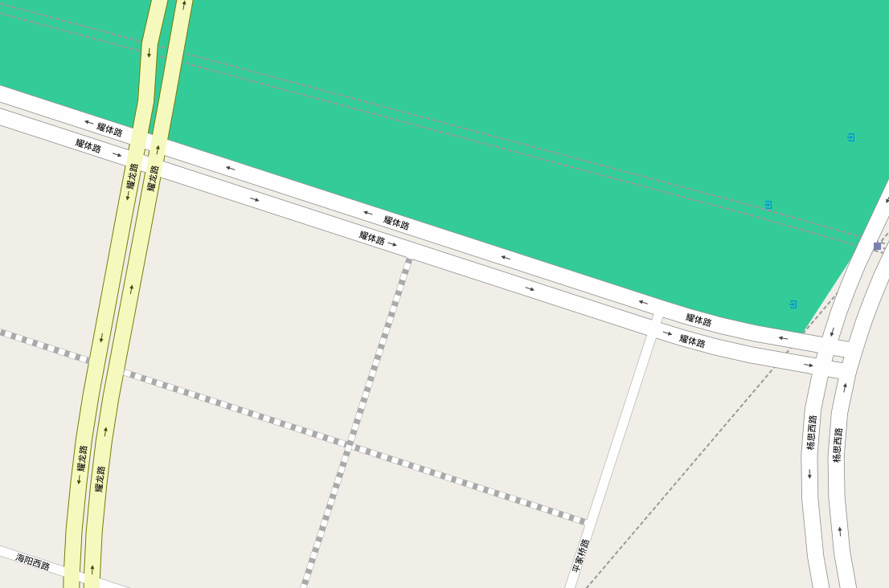
OpenStreetMap nodes transformed into coordinates
Searched color pixels in Baidu Traffic image

Slide 25
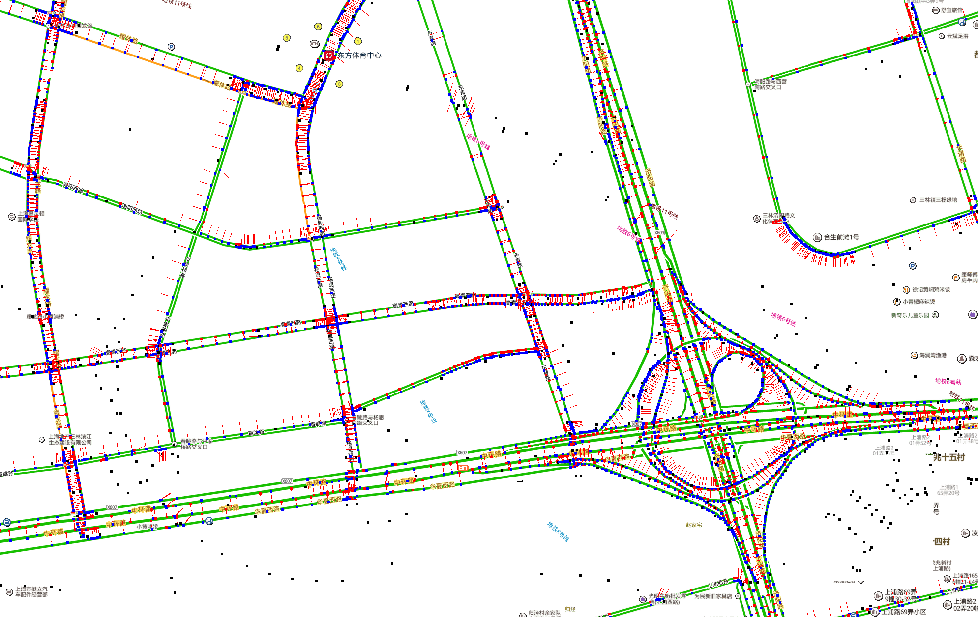
Combine & Intercept – Our program

Slide 26
OSM nodes mapped to Baidu Map coordinate
Color label pixel searched on both direction

Slide 27
Feature Engineering
Local spatial features
Global spatial features
Other more implicit features

Slide 28
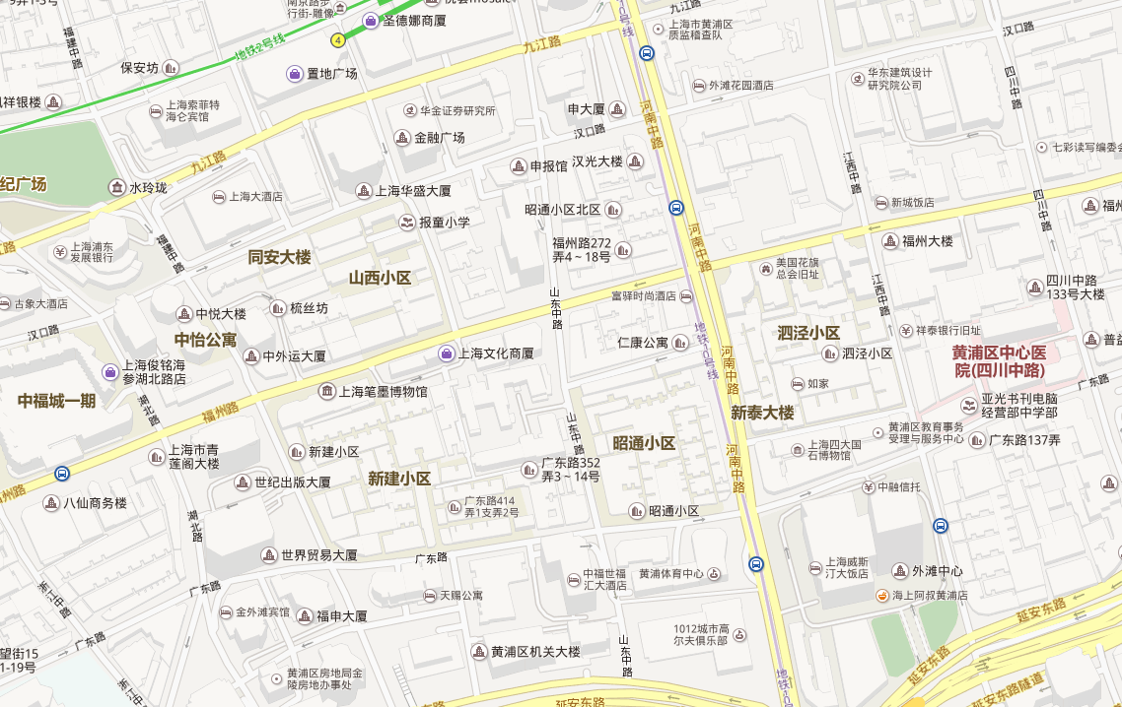
Local spatial features
Road Type
Tertiary road
Secondary road
Primary road

Slide 29
Local spatial features
Road network density
Average distance between adjacent crossroads in both direction

Slide 30





Local spatial features
POI density of each type
Also consider adjacent crossroads in both direction

Slide 31
Global spatial features
Overview of traffic flows in large urban perspective.
Reflection of commuters and driver’s thoughts and behaviors.

Slide 32
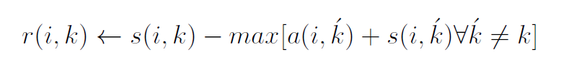
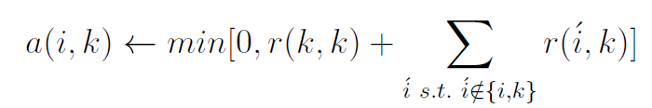
Global spatial features
Popularity and category inferred from numbers of check-ins on Dianping and Weibo.
Cluster POIs by Affinity Propagation algorithm, which chooses the number of clusters based on the data:
Responsibility: Sample k should be exemplar of i.
Availability: Sample i should choose k as its exemplar.

Slide 33
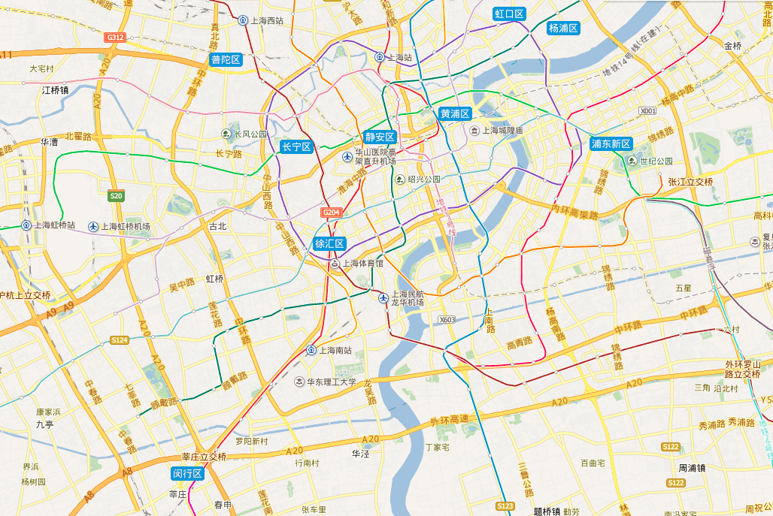
POI clusters – by popularity and type
Keys:
Commercial
Workplace
Residential
Notes:
Next we need to calculate all the routing between any two of the functional areas

Slide 34
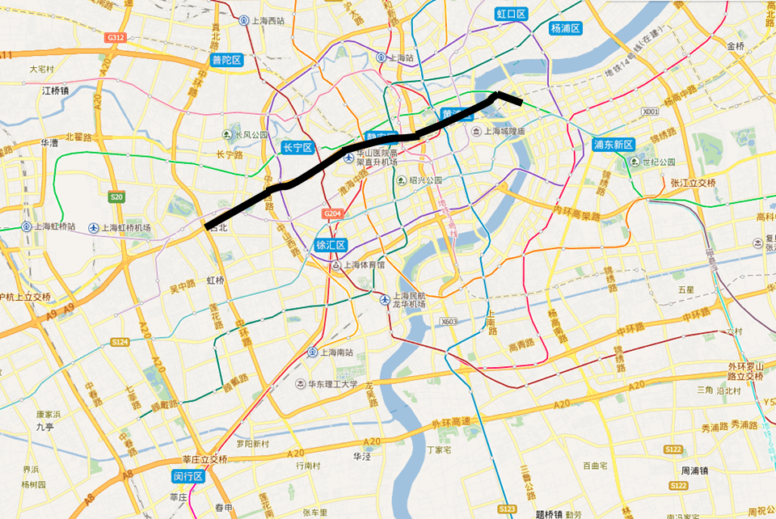
Routing between any two functional areas
Popular way choice feature on passing nodes
Calculated using A* algorithm on our OSM road network database

Slide 35
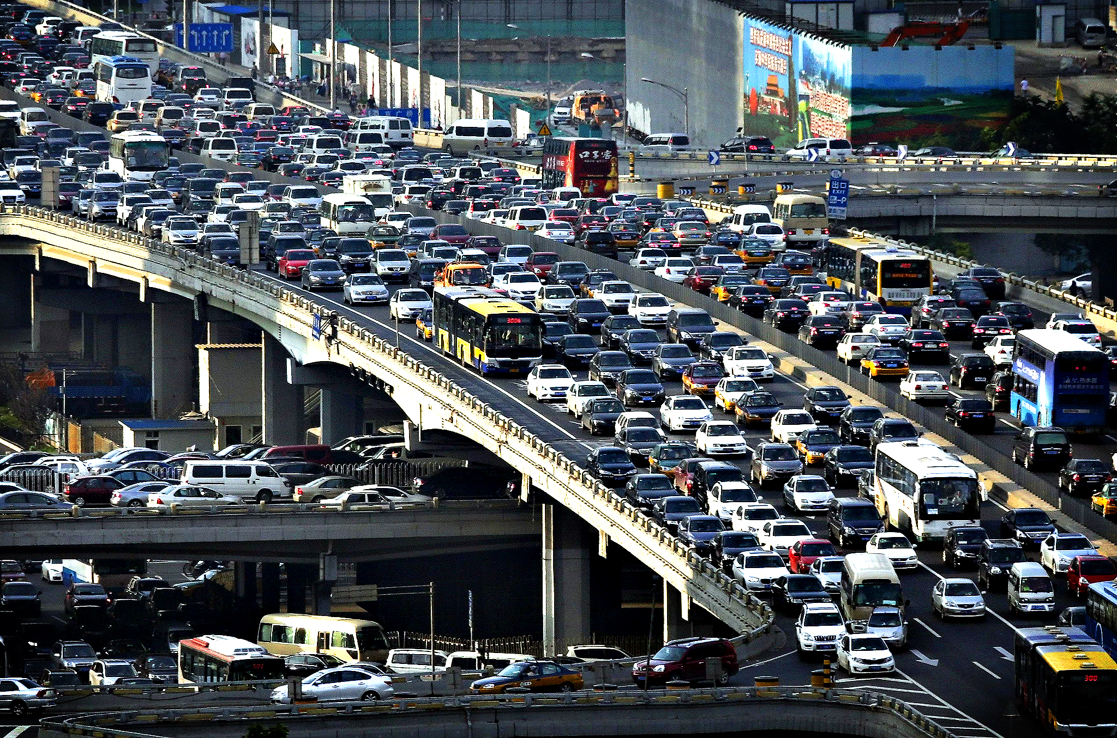
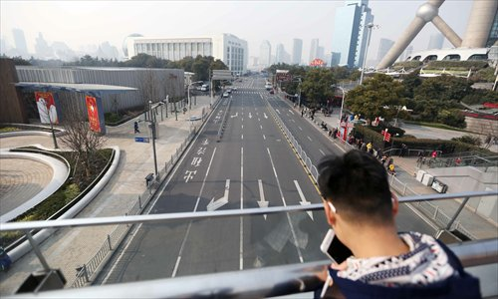
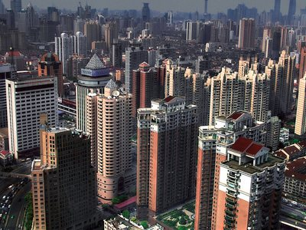

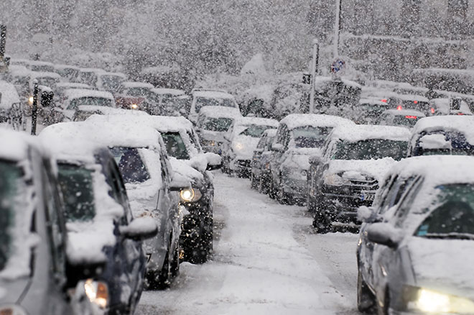
What else related to the traffic
Time of the day
Day of the week
Rental price
Weather condition
Weather condition

Slide 36
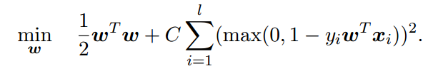
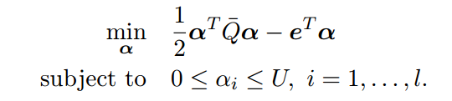
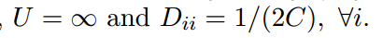
Training - Linear SVM
Categorical features to binary
Scale features to same range to normalize
Uses L2-regularized L2-loss SVC
Primal:
Dual:

Slide 37
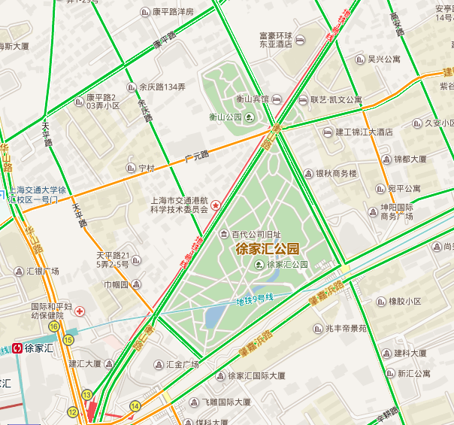
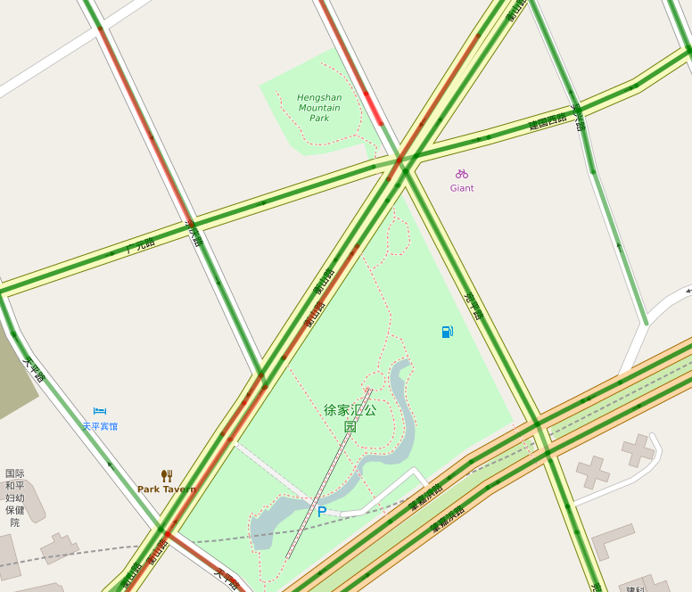
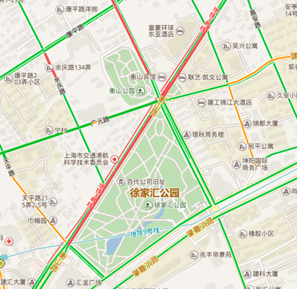
Comparison test
Baidu Map
Ours
Real Traffic
Calculate prediction accuracy against live traffic

Slide 38
Baidu Map’s overall accuracy: 82.7%
Our system’s overall accuracy: 86.7%

Slide 39
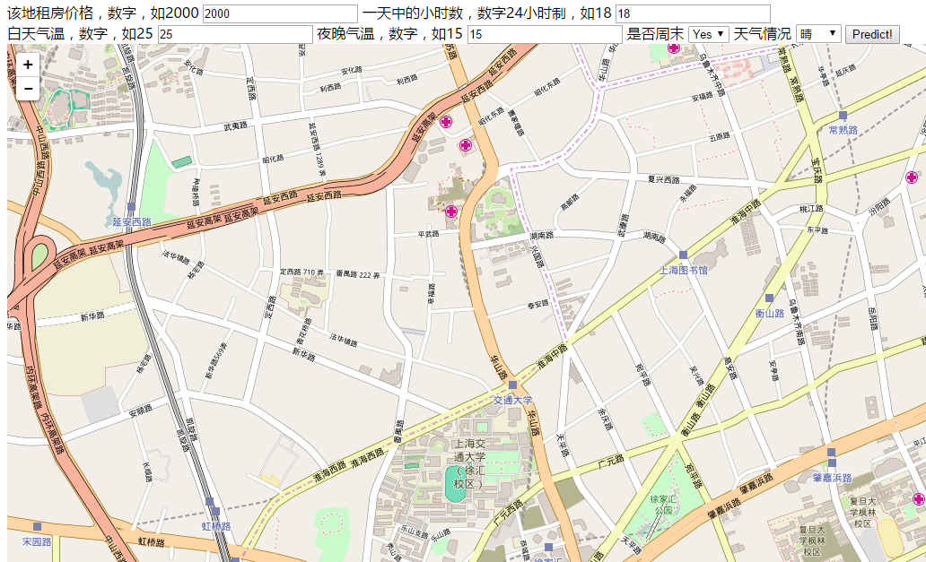
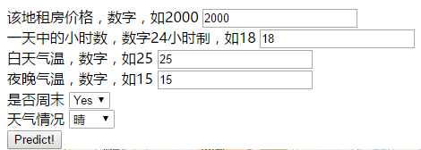
Demo showcase
Available at http://adapt.seiee.sjtu.edu.cn:8080/traffic/

Slide 40
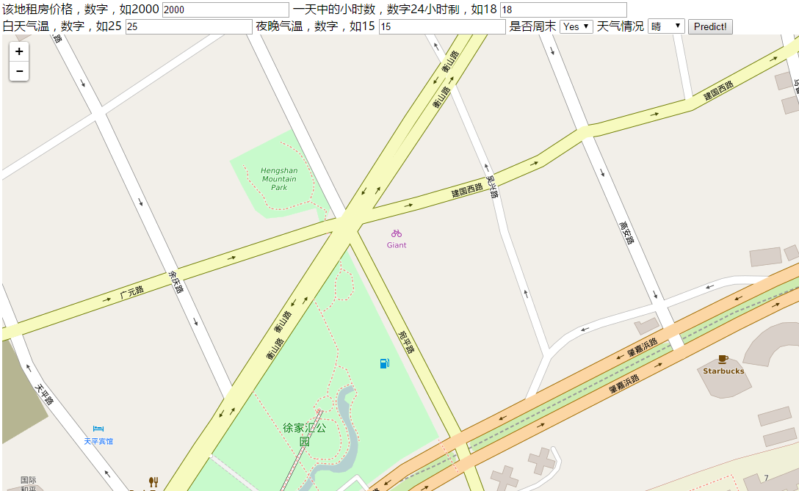

Slide 41
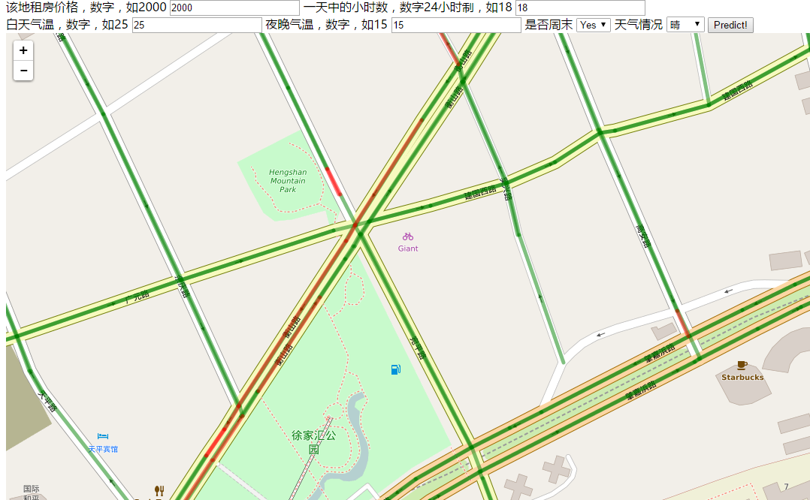
Weekend, Sunny

Slide 42
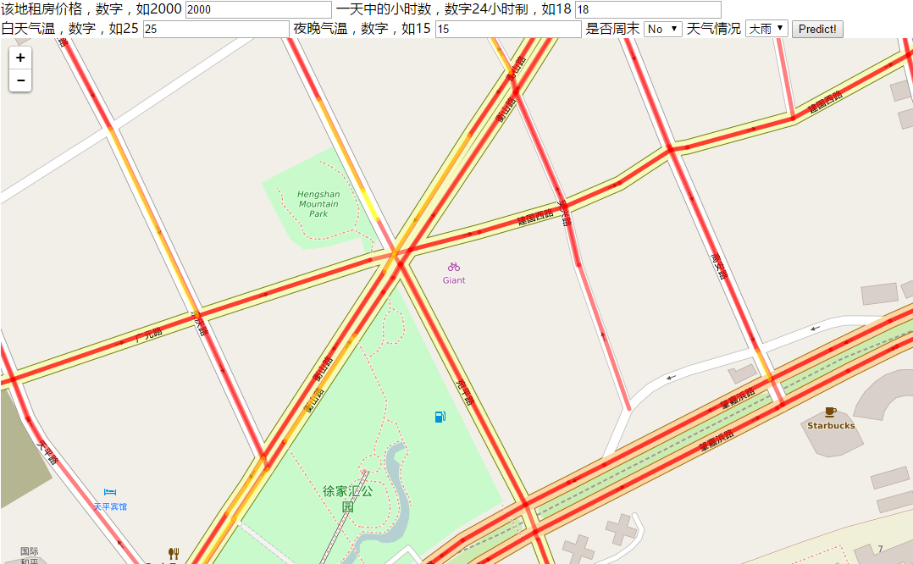
Weekday, Rush hour, Heavy Rain
Notes:
It’s overall congested

Slide 43
Conclusion
Solved challenges in data collection and feature engineering.
Achieved prediction accuracy of 0.87, outperforming Baidu Map.
Developed a web demo
Notes:
In conclusion…

Slide 44
Thanks!

Slide 45
Issues and future work
Data imbalance problem still affects the result, as the prediction rate of heavy traffic classes are relatively low.
To try new techniques and models like ensemble methods and decision trees to tackle the problem, since it is hard for linear SVM to classify such extreme imbalances.
Also consider from other perspectives of the problem like anomaly detection.

Slide 46
Training process
Class | #Occurrence | Percentage | Weight
Green | 2197252 | 0.90953 | 1
Yellow | 176517 | 0.07306 | 14
Red | 40629 | 0.01681 | 59
Deep Red | 1105 | 0.00046 | 2186
Extract features into specific format
Represent categorical features in binary form
Scale and normalize the value range to [0, 1]
Feed into LIBLINEAR to train the linear SVM model
Using class weights to compensate imbalance
Using primal L2-regularized L2-loss SVC as solver

Slide 47
Test result evaluation
Class | F1 Score
Green | 0.93
Yellow | 0.14
Red | 0.09
Deep Red | 0.01
Avg / Total | 0.87
Test data range: May 28 – June 1
Overall accuracy is good and predicts good at green class
Prediction is not done well for rare and severe traffic jams
Effects of data imbalance on model training

